Slide 1
Graphs

Slide 2
What is a Graph?
A graph G = (V,E) is composed of:
V: set of vertices
E: set of edges connecting the vertices in V
An edge e = (u,v) is a pair of vertices
Example:
a
b
V= {a,b,c,d,e}
E= {(a,b),(a,c),(a,d),
(b,e),(c,d),(c,e),
(d,e)}
c
d
e

Slide 3
Applications
electronic circuits
networks (roads, flights, communications)
CS16
JFK
LAX
LAX
STL
HNL
DFW
FTL

Slide 4

Terminology:
Adjacent and Incident
If (v0, v1) is an edge in an undirected graph,
  v0 and v1 are adjacent
  The edge (v0, v1) is incident on vertices v0 and v1
If <v0, v1> is an edge in a directed graph
  v0 is adjacent to v1, and v1 is adjacent from v0
  The edge <v0, v1> is incident on v0 and v1
v0
v1
v0
v1

Slide 5
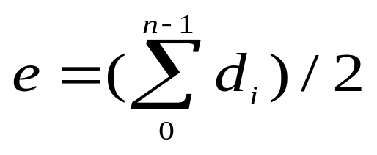
Terminology:
Degree of a Vertex
The degree of a vertex is the number of edges incident to that vertex
For directed graph,
  the in-degree of a vertex v is the number of edges
  that have v as the head
  the out-degree of a vertex v is the number of edges
  that have v as the tail
  if di is the degree of a vertex i in a graph G with n vertices and e edges, the number of edges is
Why? Since adjacent vertices each
count the adjoining edge, it will be
counted twice

Slide 6
Examples
0
3
2
0
1
2
3
3
3
1
2
3
3
4
5
6
G1
1
1
1
3
G2
1
3
0
in:1, out: 1
directed graph
in-degree
out-degree
1
in: 1, out: 2
2
in: 1, out: 0
G3

Slide 7
Terminology:
Path
path: sequence of vertices v₁,v₂,. . .v_{k} such that consecutive vertices v_{i} and v_{i+1} are adjacent.
3
2
3
3
3
a
b
a
b
c
c
d
e
d
e
a b e d c
b e d c

Slide 8
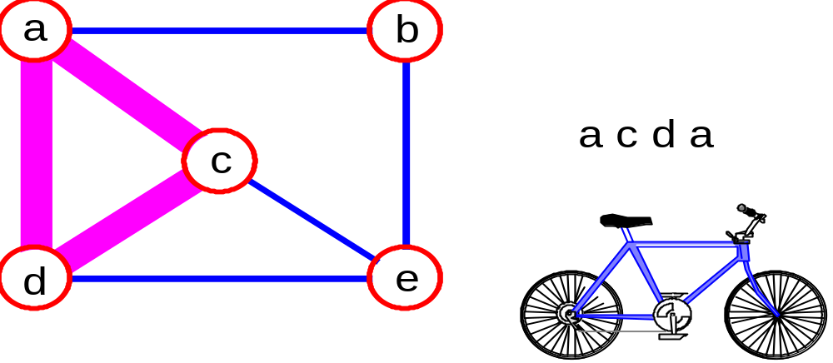
More Terminology
simple path: no repeated vertices
cycle: simple path, except that the last vertex is the same as the first vertex
a
b
b e c
c
d
e

Slide 9
Even More Terminology
connected graph: any two vertices are connected by some path
connected
not connected
Sub-graph: subset of vertices and edges forming a graph
connected component: maximal connected sub-graph. E.g., the graph below has 3 connected components.

Slide 10
Subgraphs Examples
0
0
0
1
2
0
1
2
1
2
3
1
2
3
G1
(i) (ii) (iii) (iv)
(a) Some of the sub-graph of G₁
3
0
0
0
0
0
1
1
1
1
2
2
2
(i) (ii) (iii) (iv)
(b) Some of the subgraph of G₃
G3

Slide 11
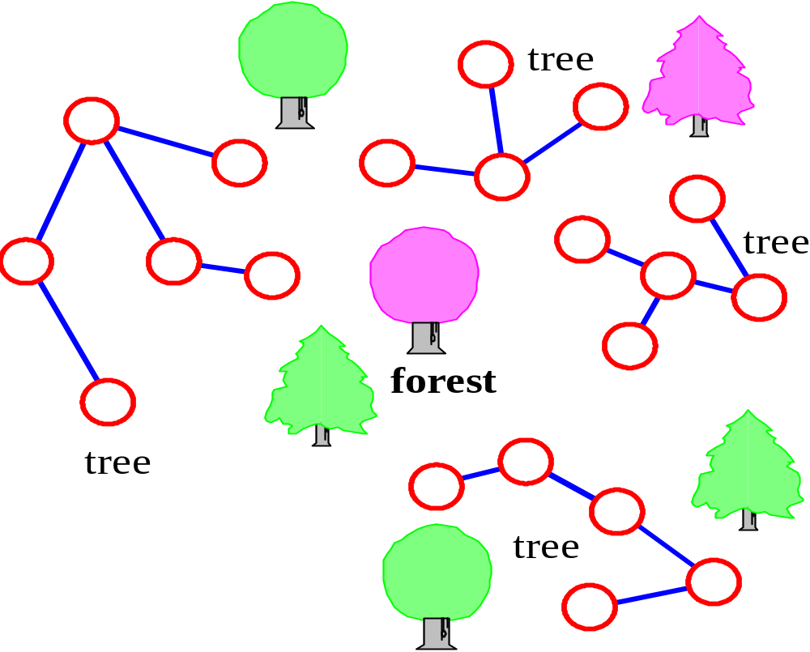
More…
tree - connected graph without cycles
forest - collection of trees

Slide 12
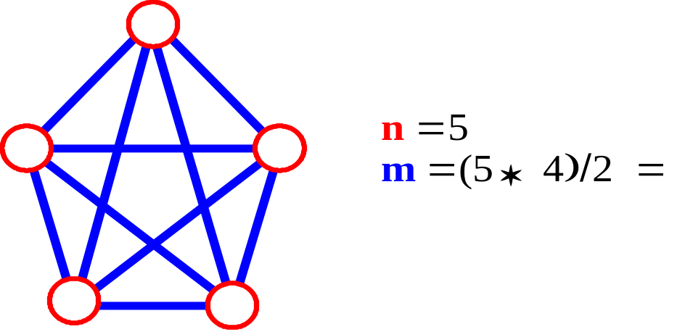

Connectivity
Let n = #vertices, and m = #edges
A complete graph: one in which all pairs of vertices are adjacent.
How many total edges in a complete graph?
  Each of the n vertices is incident to n-1 edges, however, we would have counted each edge twice! Therefore, intuitively, m = n(n -1)/2.
Therefore, if a graph is not complete, m < n(n -1)/2

Slide 13
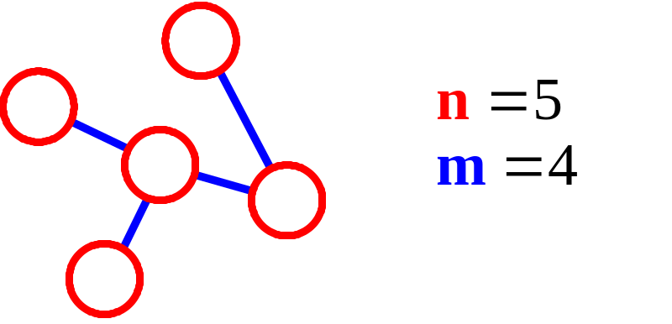
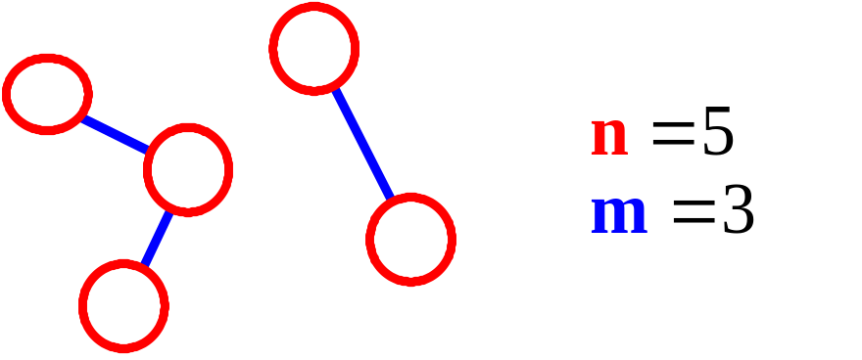
More Connectivity
n = #vertices
m = #edges
For a tree m = n - 1
If m < n - 1, G is not connected

Slide 14
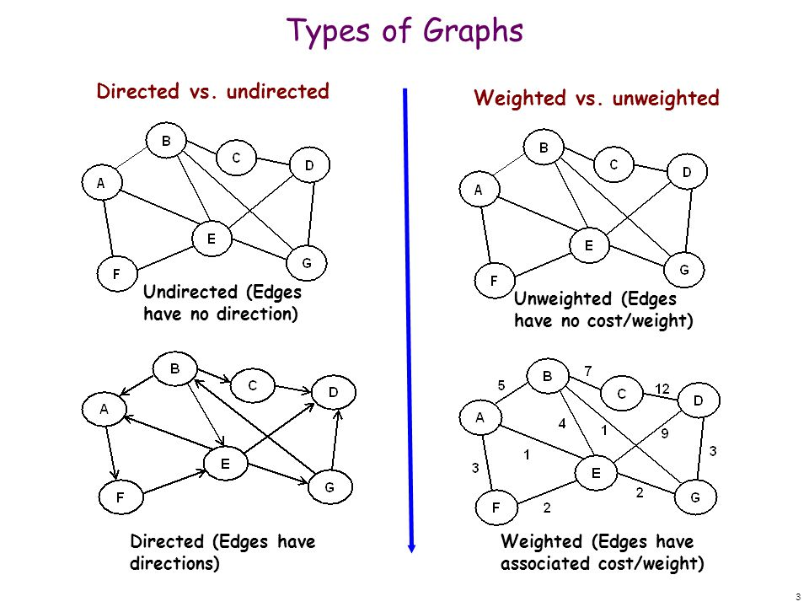

Slide 15
Oriented (Directed) Graph
A graph where edges are directed

Slide 16
Directed vs. Undirected Graph
An undirected graph is one in which the pair of vertices in a edge is unordered, (v0, v1) = (v1,v0)
A directed graph is one in which each edge is a directed pair of vertices, <v0, v1> != <v1,v0>
tail
head

Slide 17
Graph Representations
Adjacency Matrix
Adjacency Lists

Slide 18
Adjacency Matrix
Let G=(V,E) be a graph with n vertices.
The adjacency matrix of G is a two-dimensional
n by n array, say adj_mat
If the edge (vi, vj) is in E(G), adj_mat[i][j]=1
If there is no such edge in E(G), adj_mat[i][j]=0
The adjacency matrix for an undirected graph is symmetric; the adjacency matrix for a digraph
need not be symmetric

Slide 19
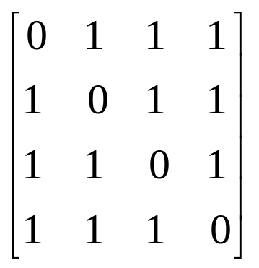
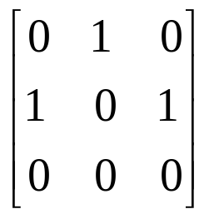
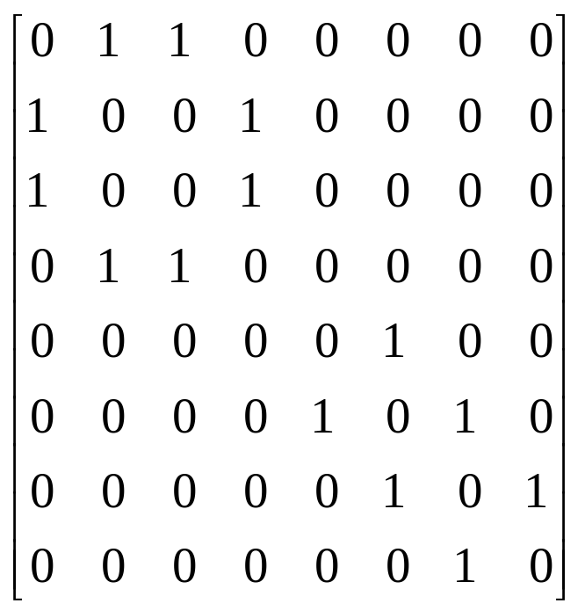
Examples for Adjacency Matrix
0
0
4
0
1
2
2
1
5
3
1
3
6
0 1 2 3
0 1 2 3
7
2
G2
G1
symmetric
G3

Slide 20
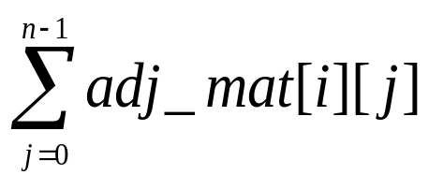
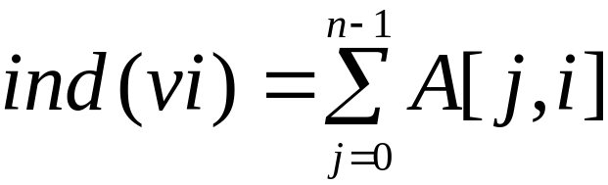
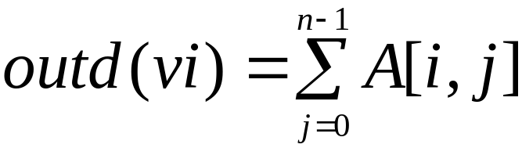
Merits of Adjacency Matrix
From the adjacency matrix, to determine the connection of vertices is easy
The degree of a vertex is
For a digraph (= directed graph), the row sum is the out_degree, while the column sum is the in_degree

Slide 21
Adjacency Lists (data structures)
Each row in adjacency matrix is represented as an adjacency list.
#define MAX_VERTICES 50
typedef struct node *node_pointer;
typedef struct node {
int vertex;
struct node *link;
};
node_pointer graph[MAX_VERTICES];
int n=0; /* vertices currently in use */

Slide 22
0
0
4
2
1
5
1
2
3
6
3
7
0
1
2
3
1
2
3
0
1
2
3
4
5
6
7
1
2
0
2
3
0
3
0
1
3
0
3
0
1
2
1
2
G1
0
5
4
6
0
1
2
1
5
7
0
2
1
6
G3
G4
2
An undirected graph with n vertices and e edges ==> n head nodes and 2e list nodes

